Slide 1





All About Me
Year 7 Health
Lesson 1
2024

Slide 2
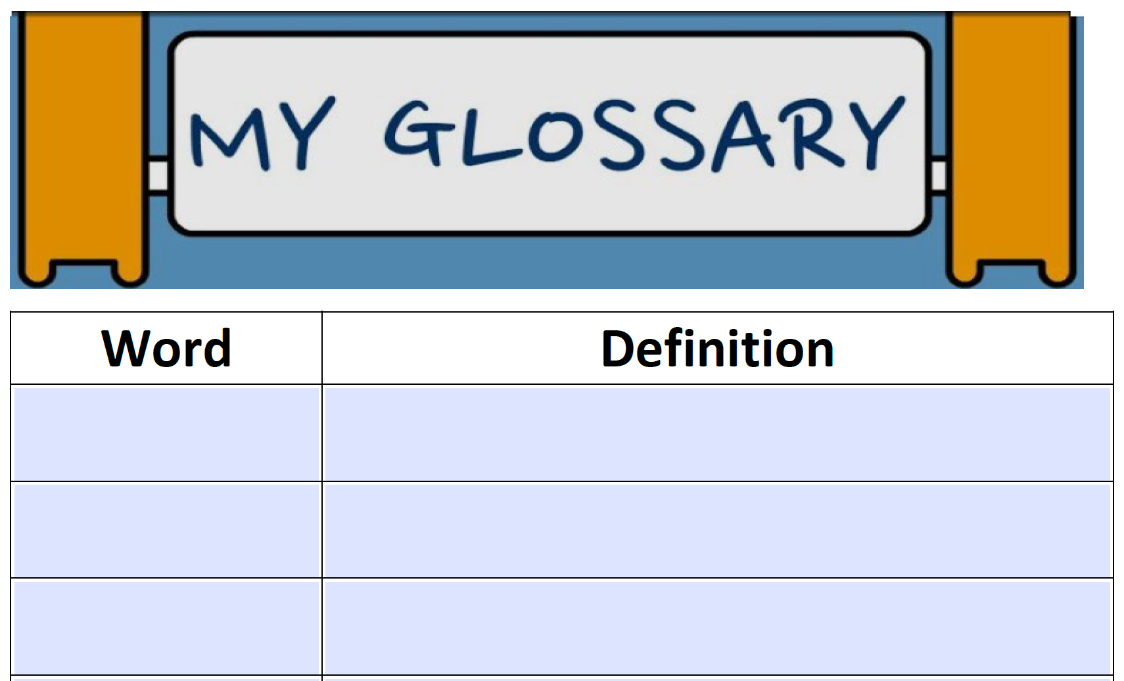

Word Vocabulary
Sometimes in health we will use words that you do not understand. Each week, your aim is to write down two new words and their definitions.
You can write down new words that you hear and learn, or your teacher may ask you to add specific words.

Slide 3

In the first 5 minutes of each lesson you will complete your revision page, you will find these throughout your booklet.
The revision page consists of three questions. It will need to be completed in detail. One word answers will not be accepted.
The three questions :
What two concepts or ideas did I learn in class last week?
What did I find interesting about last week’s lesson? Provide a specific example.
Any questions or new words you have learnt?
The teacher will go over this each lesson with you to see what you have learnt. It is a great way for you to revisit content and test your memory.

Slide 4

TOP TIPS TO CRUISE THROUGH…
Know the program outline and when your assessment tasks are due.
Course program and assessment outline are at the front of your books each term.
Double check with your teacher if:
You are unsure of a due date.
You are unsure how to submit your work.
How to access your student emails and know your student email.
Every student has an email address: Firstname.lastname@student.education.wa.edu.au
If notices get posted through Connect an email will also be sent out.
Teachers may need to pass on information, so it is important that emails are regularly checked.
How to write appropriate emails to your teachers.
Notes:
Assessment task submission – students can submit their work in a way outlined by the teacher. Some tasks may require electronic submission, so it is important that students know how to submit through Connect or how to send via email. Some tasks may require a hard copy submission, so it is important that students know when their work is due or where to submit work via staff HPE pigeonholes (if you use them).
Student emails – accessible via connect.

Slide 5
TOP TIPS TO CRUISE THROUGH…
How to write appropriate emails to your teachers.
Your teachers email address can also be found through your class Connect page.
DO:
Address your teacher/email recipient correctly
E.g., Dear ______, or Hi ________,
Sign off in an appropriate way
E.g., use ‘Thanks,’ ‘Kind regards,’ or ‘Sincerely’
Use appropriate language and grammar and use full sentences
Proof-read your emails
DON’T:
Use slang or ‘text’ speak
Use inappropriate language
ASK if you are unsure of anything! Don’t leave it to the last minute if you are having any issues with work or assessments.
Notes:
Add anything else you want/expect from your class.

Slide 6
TOP TIPS TO CRUISE THROUGH…
How to access and use Connect.
Through Connect you can view all your classes.
For Health, all work will be uploaded to Connect for you to access. This includes your electronic workbooks (E-book) which you will use from Term 2 onwards.
Assignments can be submitted through Connect.
Notices outlining important information for your classes will be posted to Connect.
How to access IT Help through SharePoint (next slides).
How to download ADOBE.
This is an app/program that you will need to be able to use your E-books from Term 2 onwards.
Notes:
Tell students if you will upload your content to the Library or Content section on Connect.

Slide 7
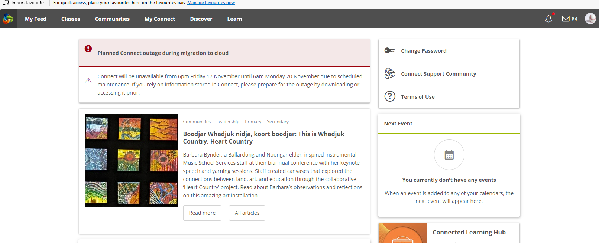
Step 1: Access Student Sharepoint
Log into Connect
Google: DOE connect → same login you use to access the WiFi at school, or the school computers.
Open your emails by clicking the envelope in the top right corner.
Notes:
From here, students can send and receive emails.

Slide 8
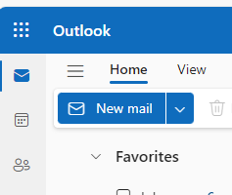
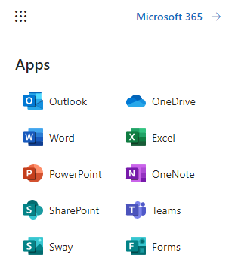
Step 1: Access Student Sharepoint
Once in Outlook, click the square grid in the top left corner.
Click SharePoint.

Slide 9
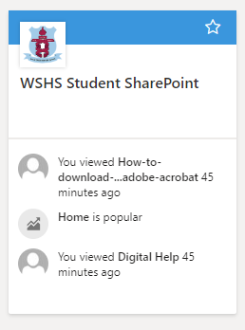
Step 1: Access Student SHarepoint
Open WSHS Student SharePoint.
Notes:
The box should have a heading saying ‘Student SharePoint’ that they click.

Slide 10
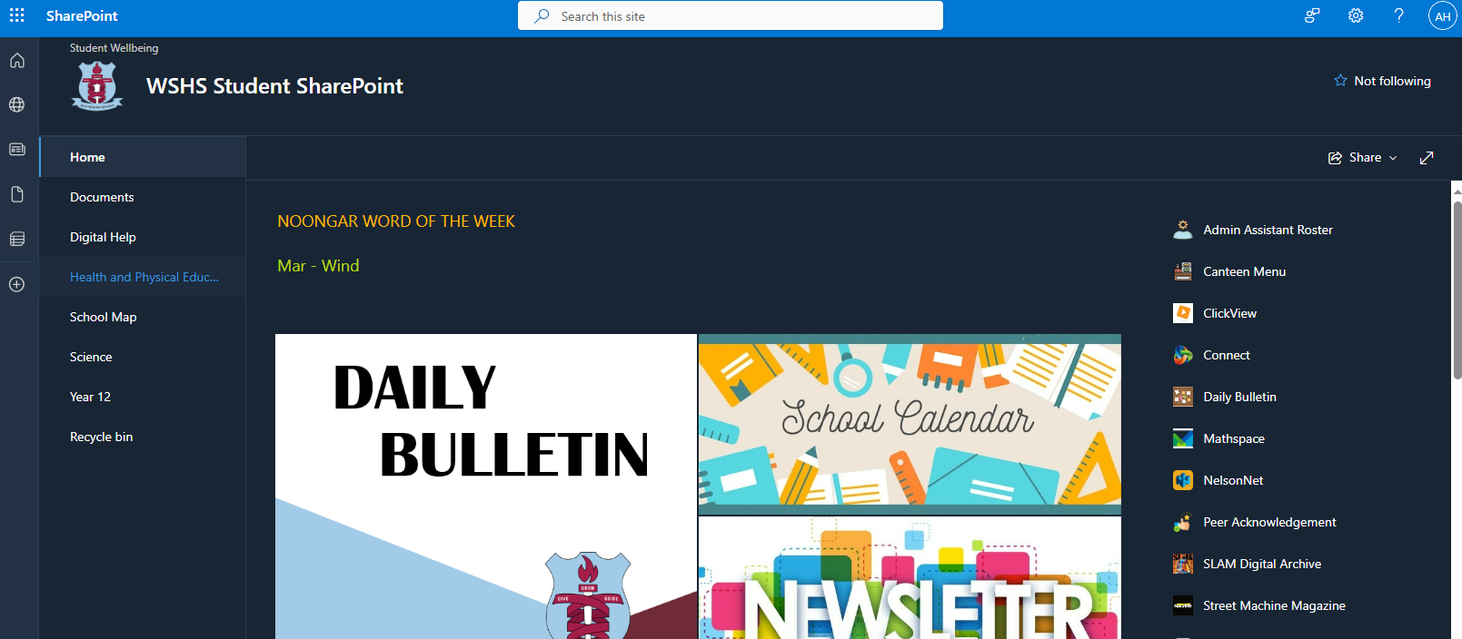
Step 1: Access Student SHarepoint
On this page there is a range of videos designed for you to use to access any help for IT related things at WSHS.
Help videos include, but are not limited to, Email Etiquette, downloading ADOBE and opening work through ADOBE.
Save this page as a bookmark for easy access.
Choose ‘Digital Help’ from the left column.

Slide 11
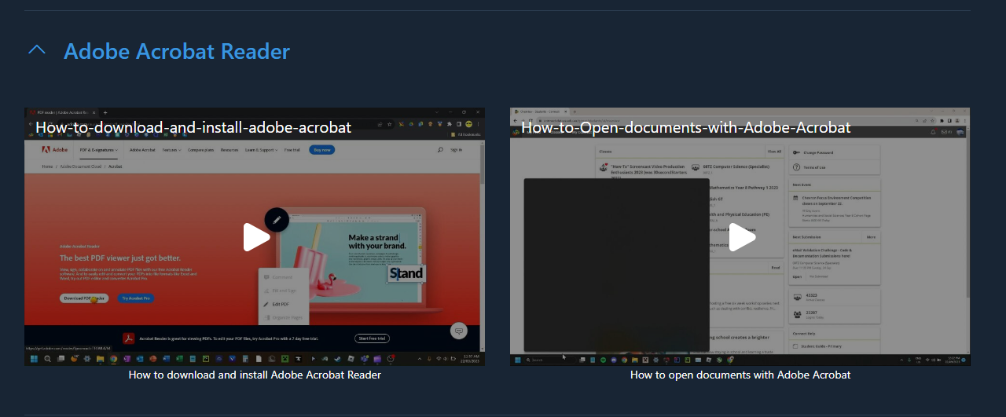
Step 2: Download Adobe ACROBAT READER
On the Digital Help SharePoint page, you will be able to find and access a variety of videos with help on how to use a range of different programs.
Scroll to the section on ‘Adobe Acrobat Reader’ (it will be at the bottom).
Watch the video ‘how to download and install adobe acrobat’ as a class and follow the instructions on how to download to your device.
Leave this page open in your browser to revisit for Step 4.
Notes:
Digital Help
Digital Help (sharepoint.com)

Slide 12
Step 3: Download Student E-book
Next you need to download your Student E-Book for Term 2 from Connect.
Go to your Health Connect Class.
Follow your teachers' instructions on where to find your workbook.
Create a new folder on your device’s desktop called ‘Year 7 Health 2024.’
Download the E-Book and save it to this new folder you have created.
If it asks for a password, ask your teacher.
Notes:
Instruct students on where to find the workbook based on where you upload it – Library or Content section?

Slide 13
Step 4: Open your E-book in Adobe
Go back to the Student SharePoint - Digital Help page.
Watch the video ‘how to open documents with Adobe Acrobat’ and follow the instructions.
Alternatively:
Open the Adobe Acrobat app on your device.
Click File – open.
Open your workbook from the folder you just created and saved it into.
Ask your teacher for the password.
Add your name and your teachers name to the front.
Save your work.
Re-open to check that it saved your edits.

Slide 14



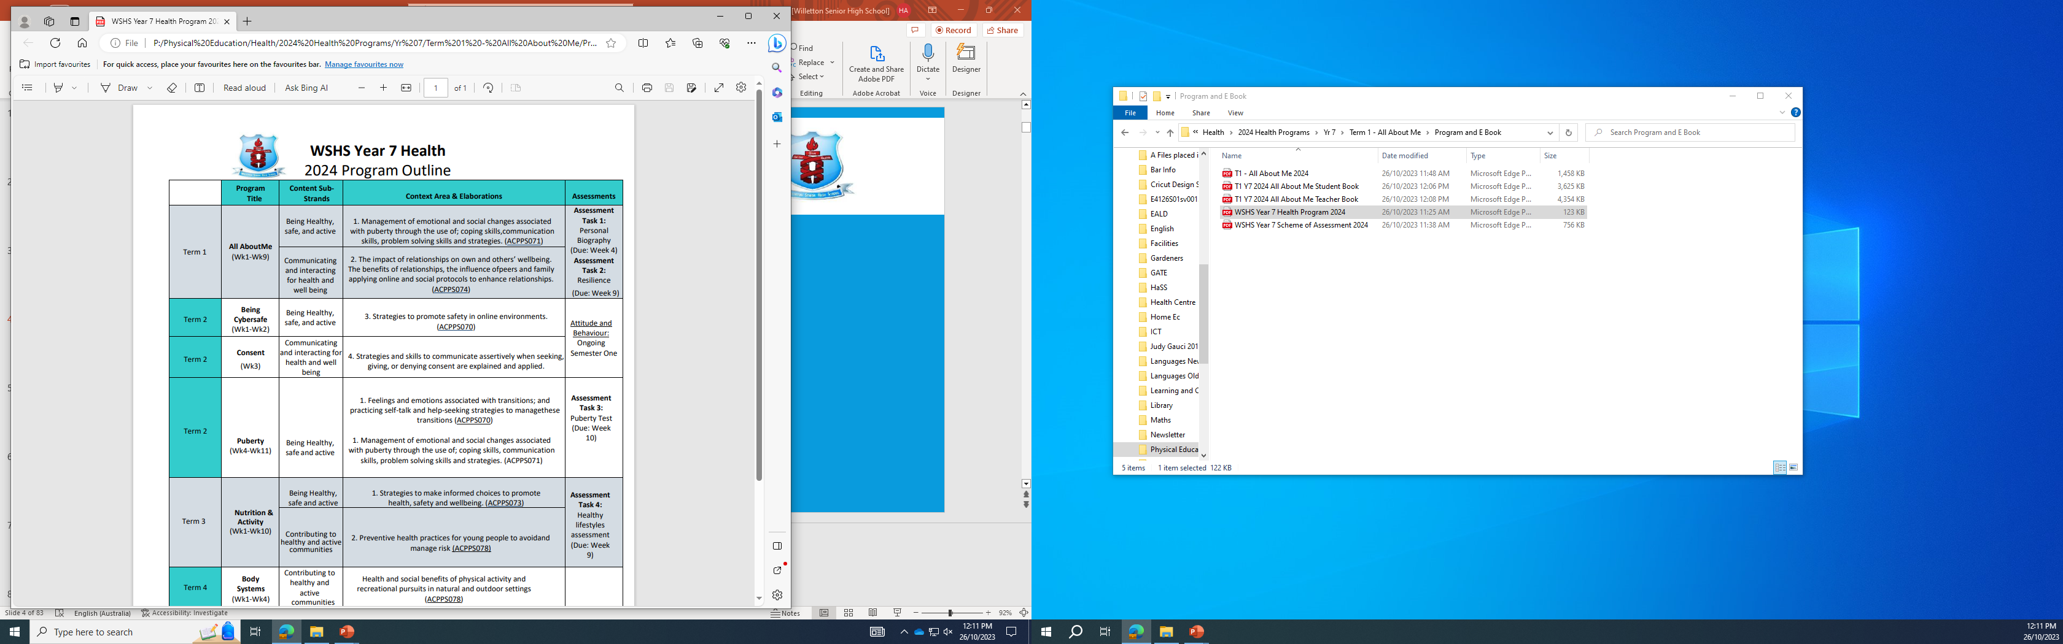
Remember to refer to the Program Outline to see what assessments you have coming up
WSHS Year 7 Health
2024 Program Outline

Slide 15

Activity 1: Ice Breaker Activity
Name Chain:
Students form a circle and the first person says their name.
The next person repeats the first person's name and adds their own.
This continues until the name chain reaches the last person.
To make it more challenging, you can have the group try to recite the entire name chain in reverse order.
Or
Speed Friending:
Arrange the classroom into two lines, with students facing each other.
Each pair has a set amount of time (e.g., 2 minutes) to talk and get to know each other.
When the time is up, one line moves one step to the right, and they start a new conversation with the next person.
Continue until students have interacted with several classmates.
This activity allows students to meet new people and practice their conversation skills.
Conversation topics:
Favourite things (sport, food, colour, movie, tv show etc.)
Family
Hobbies
Things to look forward to with high school

Slide 16

Activity 2: Ice Breaker Activity
Two Truths and a Lie:
Each student takes turns sharing two true statements and one false statement about themselves.
The rest of the group tries to guess which statement is the lie.
This activity helps students get to know each other in a fun way.
Or
Would You Rather…:
Present students with a series of "Would you rather" scenarios, such as ”would you rather have the ability to fly or be invisible?"
Students take turns sharing their choices and explaining their reasoning.
This activity encourages discussion and helps students learn more about each other's preferences.
Notes:
Example questions to ask for “Would you rather”
Would you rather have the ability to speak every language fluently or be able to play every musical instrument?
Would you rather spend a day exploring outer space or exploring the depths of the ocean?
Would you rather have the power to become invisible or the power to read minds?
Would you rather always have to hop on one foot or only be able to walk backward?
Would you rather be able to fly like a bird or swim like a fish?
Would you rather have a photographic memory or the ability to pause time?
Would you rather have a pet dinosaur or a pet dragon?
Would you rather live in a world without technology or a world without animals?
Would you rather be able to teleport anywhere instantly or have the power to heal any injury or illness?
Would you rather be able to travel back in time or into the future?

Slide 17
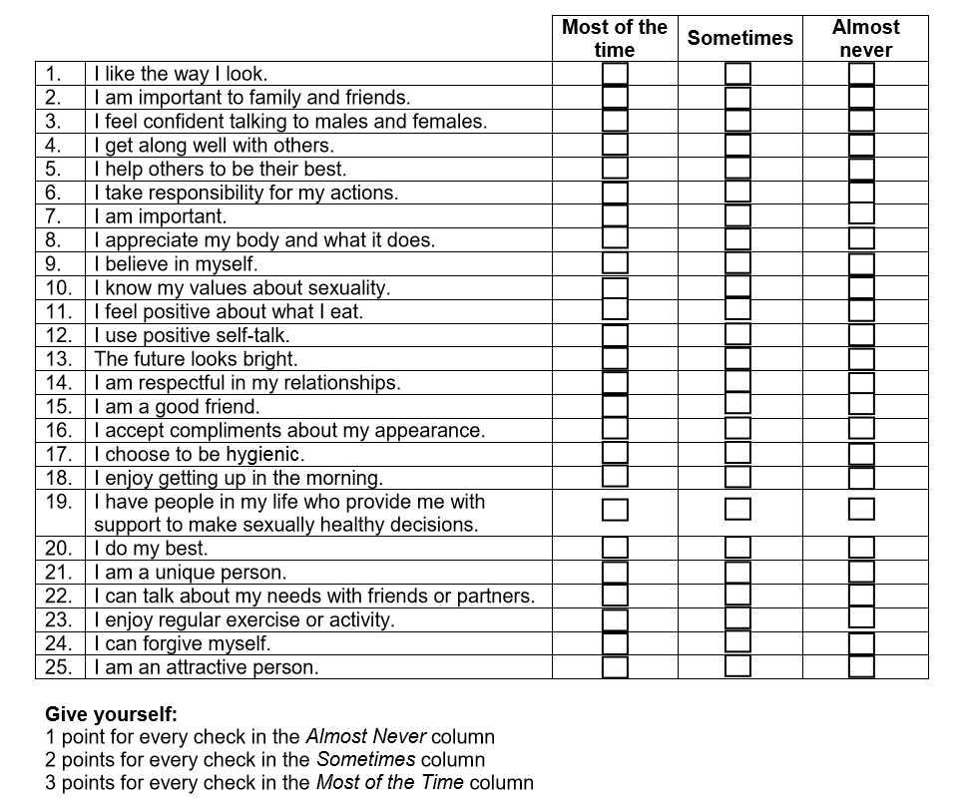
Activity 3: What I think about myself (Pg. 6)
In the following activity you need to tick one of the boxes (most of the time/sometimes/almost never) to describe what you think of yourself.
There is no right or wrong answer.
Once finished add your points up and check your score to see what you think of yourself.
1 point – for clicking the Almost never column
2 points – for clicking the Sometimes column
3 points – for clicking the Most of the time column
You can use these points as inspiration for our next activity.

Slide 18

Activity 4: A letter to me! (Pg. 7)
For this activity you will write a letter to your future self!
I will collect these letters and hold onto them.
I will not read them!!
You will receive your letters back at the end of the year.
DUE: At the start of the lesson next week (week 2)

Slide 19
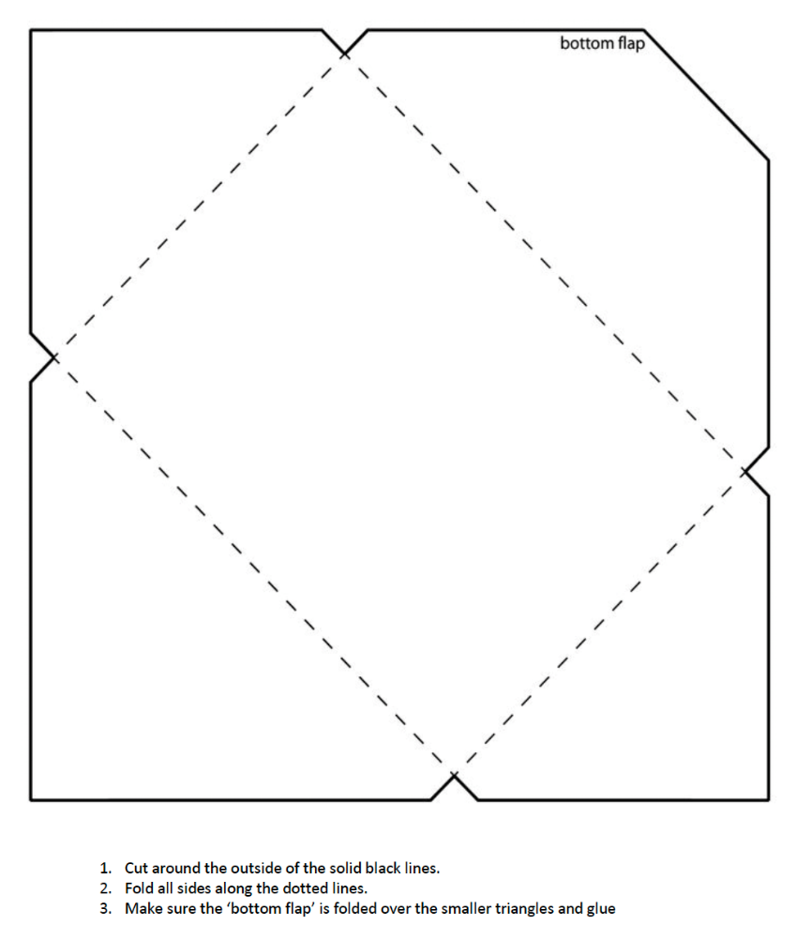
Step 1: Create your envelope
Collect an envelope template
Cut along the solid black lines
Fold along the dotted black lines
Fold your bottom flap up first, then glue the two side flaps to the edge of the bottom one
DON’T SEAL IT SHUT YET!!
Notes:
You can print these envelope templates onto coloured paper, or white paper.
Students will need scissors and glue, or tape. Students can also decorate their envelope.
ALTERNATIVE: Give students their own, normal envelope instead of making their own.

Slide 20

Step 2: Write your letter
Write the letter as if you are introducing yourself to someone new. Include as much information as you can about yourself. Some suggestions are provided below:
How you look right now – height, age, hair, clothes etc.
Family dynamic – do you get along? Do you have siblings? Are you all similar?
Home life – do you do chores? What chores? Do you earn pocket money?
Do you have any pets? What is your dream pet?
Who are your closest friends and what you do when you hang out with them?
What you like to do in your spare time (sports, hobbies, reading, collecting etc.)
What you do and don’t like about school.
Your likes and dislikes in music, movies, food, TV etc.
What you might like to do when you leave school
Anything you are looking forward to this year (holidays, exciting events, milestones, anything at school etc.)
Do you have a crush?
Do you have certain feelings towards drugs and alcohol?
If you had a big lotto win tomorrow, what would you spend the money on?
Finish off by writing yourself a message for the future!
Minimum length = half a page. Maximum length = full page
Notes:
Students don’t have to include all dot points – they are there to help students think.

Slide 21
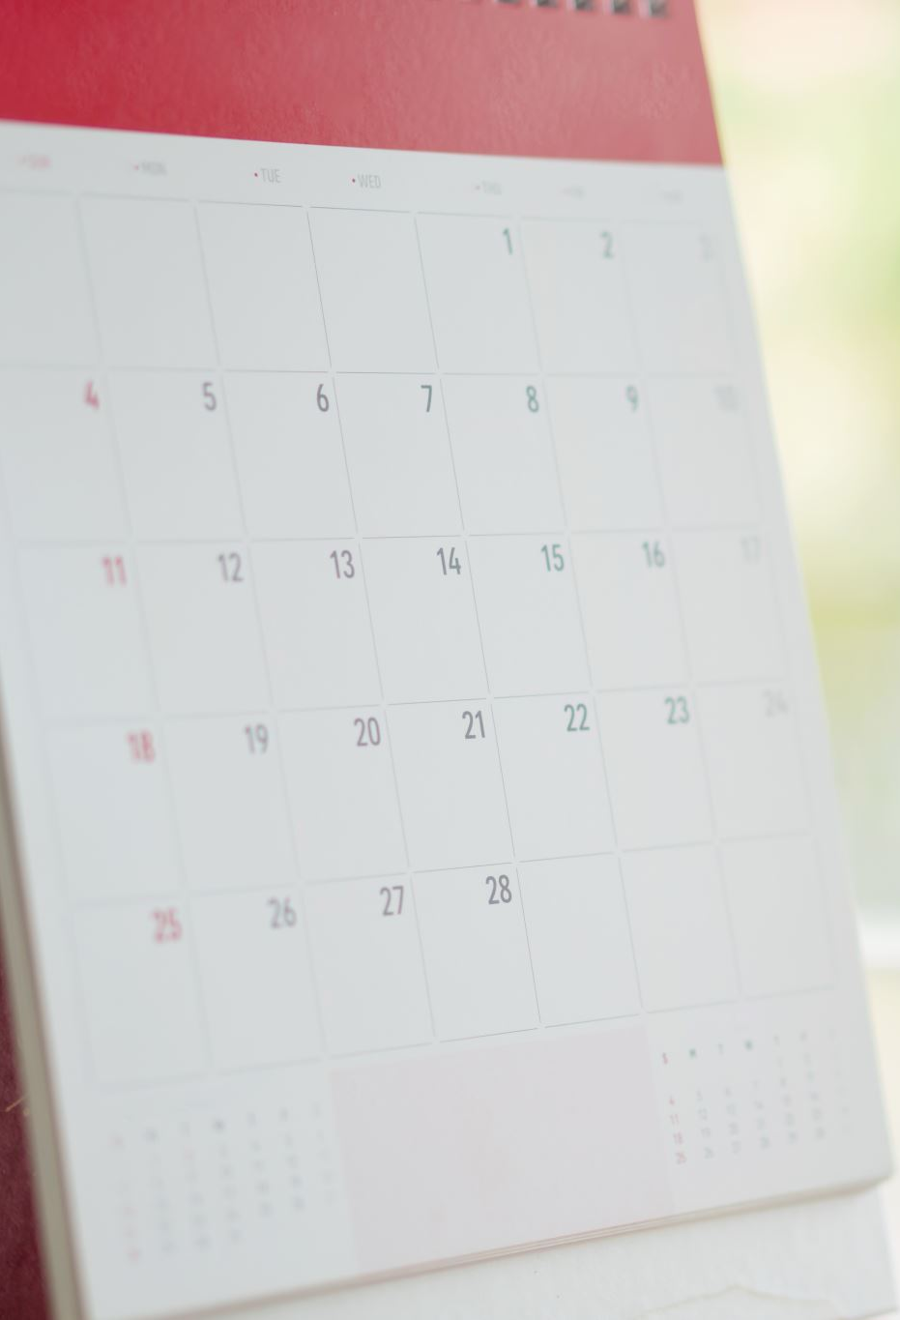
Step 3: Seal your letter
Before sealing your letter, you might want to decorate your envelope!
On your envelope, make sure you write your full name so that it can be returned to you at the end of the year.
Seal your letter shut and give it to me!
** I WILL NOT OPEN YOUR LETTER!
YOU WILL GET IT BACK AT THE END OF THE YEAR!**
DUE: At the start of the lesson next week (week 2)

